Slide 1
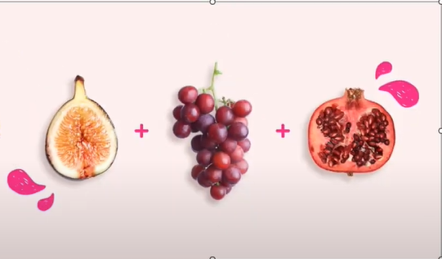

Slide 2
FRIUT NAME
In botany , a fruit is the seed -bearing structure in flowering plants that is formed from the ovary after flowering (see Fruit
Anatomy).

Slide 3
FRIUT NAME
In botany , a fruit is the seed -bearing structure in flowering plants that is formed from the ovary after flowering (see Fruit
Anatomy).

Slide 4
FRIUT NAME
In botany , a fruit is the seed -bearing structure in flowering plants that is formed from the ovary after flowering (see Fruit
Anatomy).

